Slide 1

Service World
Md. Faisal Hossain
201-35-3020
Section-A
Department of Software Engineering
Daffodil International University

Slide 2


Why This Project?
Difficulty in finding service providers like:
Electricians
Carpenters
Plumbers
Try to make the activities easier than before
Provide user friendly interface

Slide 3

OVERVIEW
This is an website named Service World
Service Provider can also register
Service Receiver can register
Receiver can find service providers within their area

Slide 4

GOAL
Creating a platform to connect receiver and provider
Provide better quality of work
Better time management
Enhancing customer satisfaction
Enhancing job satisfaction

Slide 5

FEATURES
User registration
Service receiver can search service provider with their area
Registered user can login into the system
User can review service providers
User dashboard
Admin can update user information
Admin can remove any user

Slide 6

STACKHOLDERS
Admin
User
Service Recipient
Service Provider

Slide 7

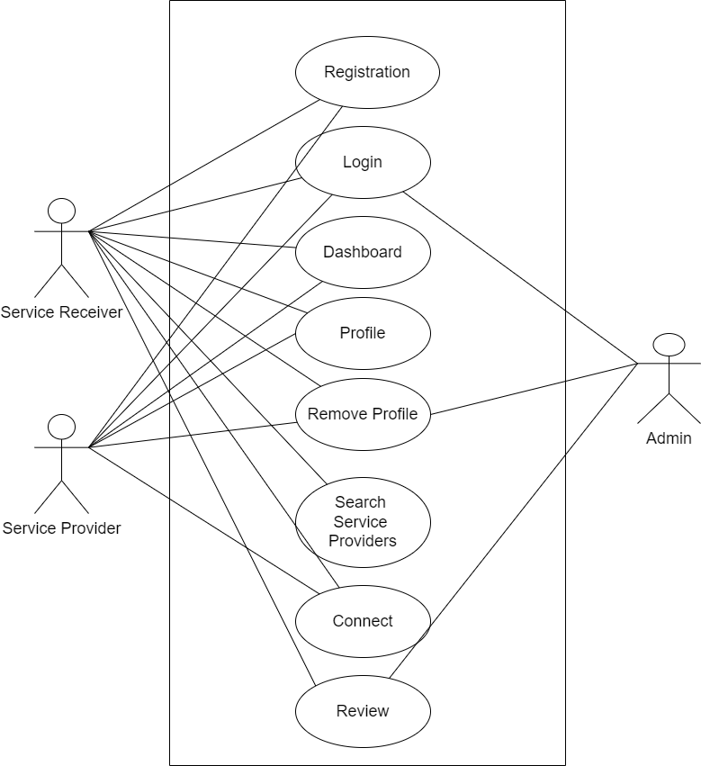
USE CASE

Slide 8
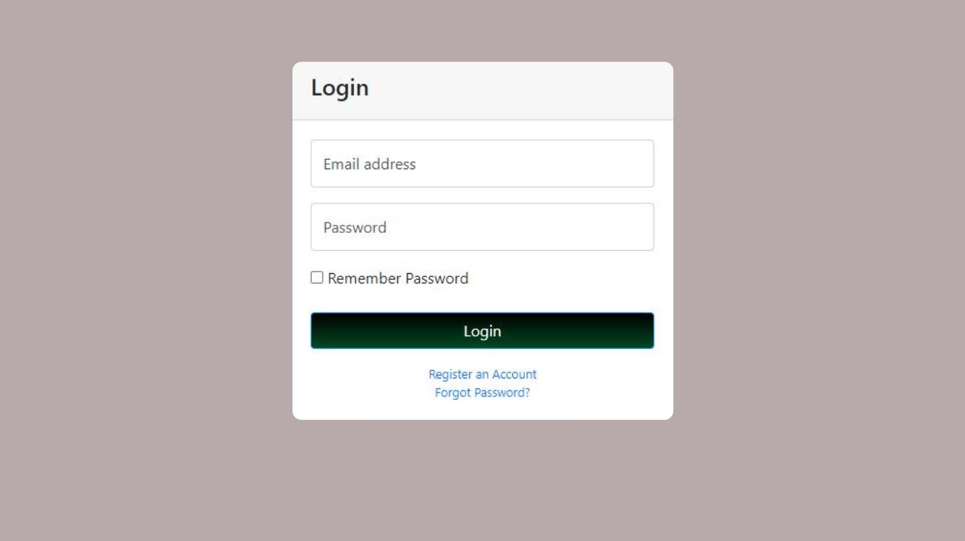

Slide 9
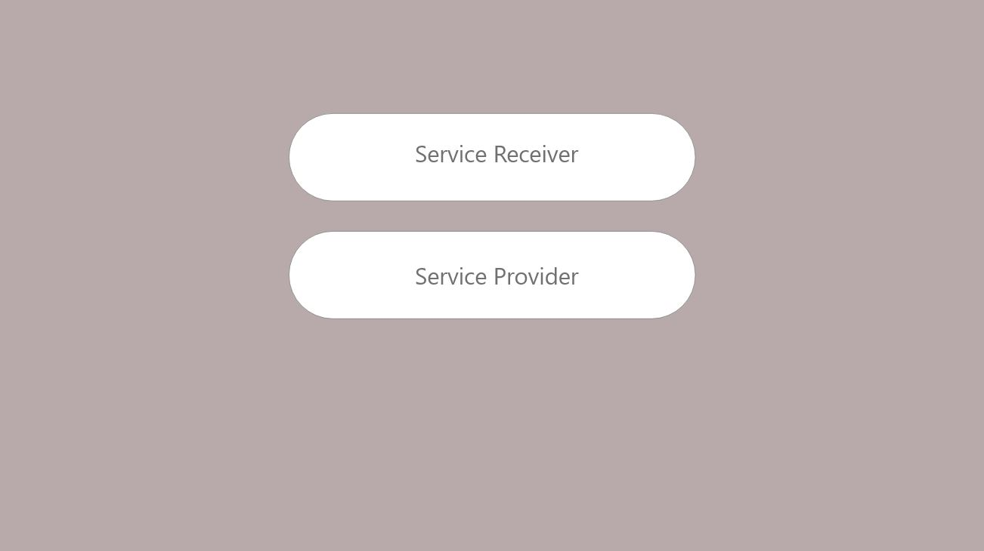

Slide 10
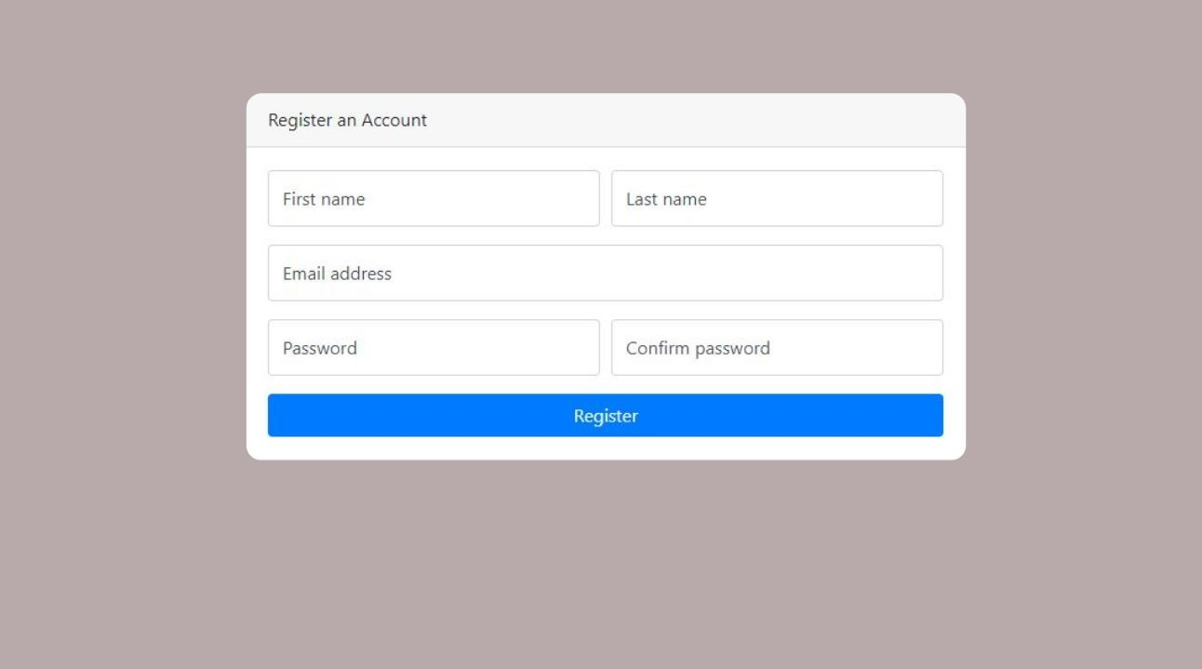

Slide 11
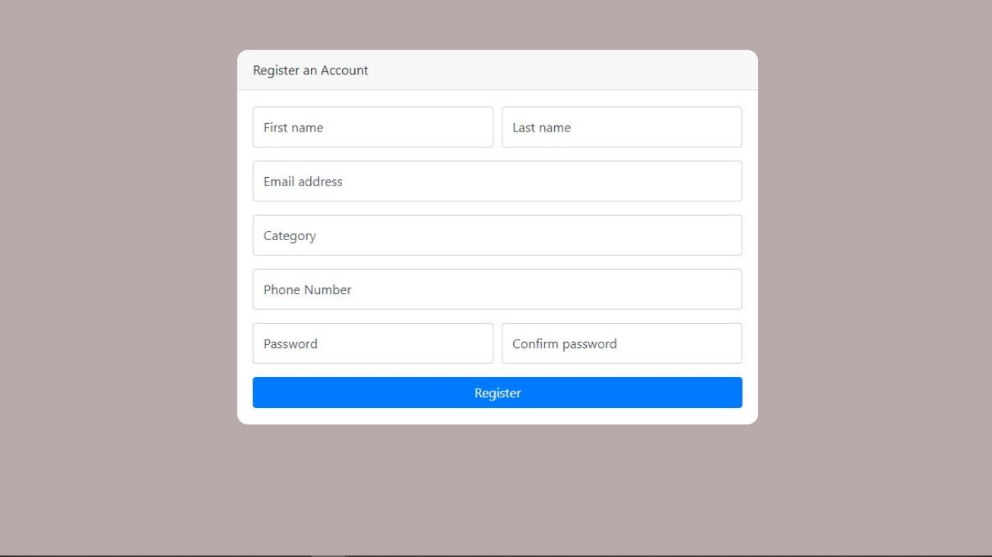

Slide 12
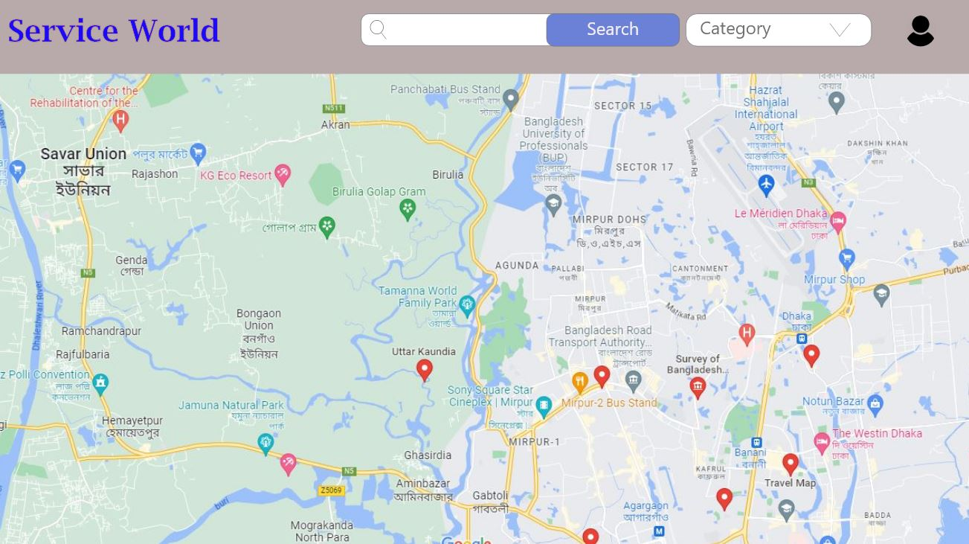

Slide 13
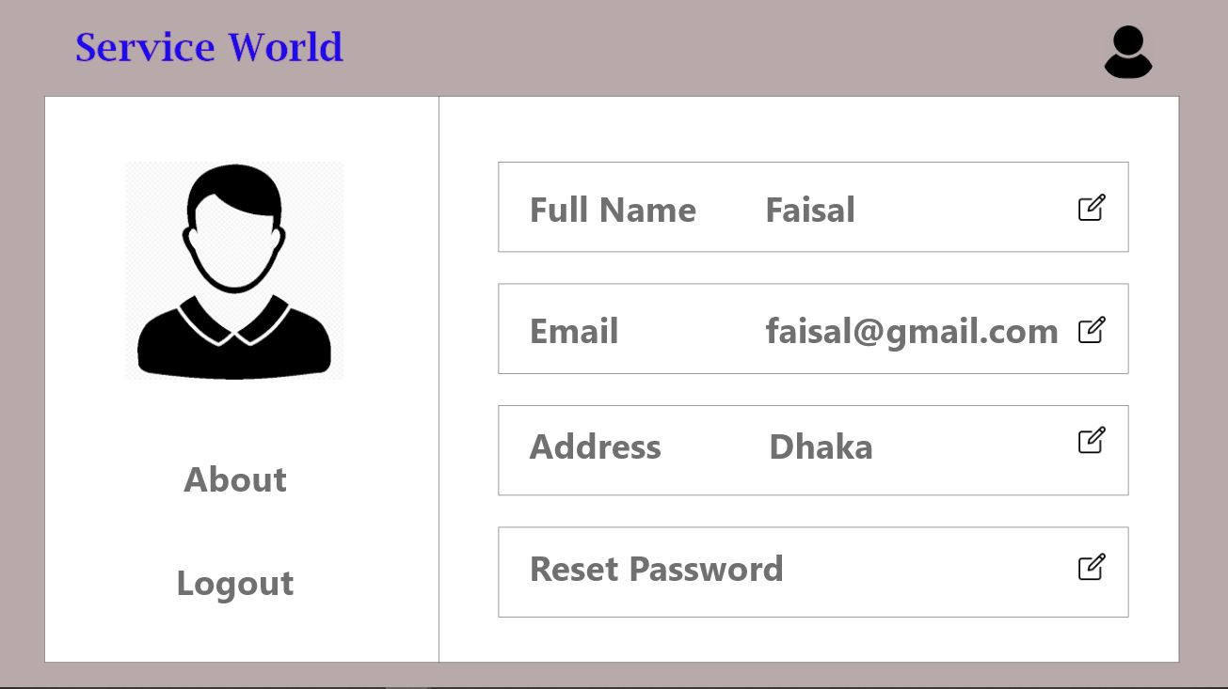

Slide 14
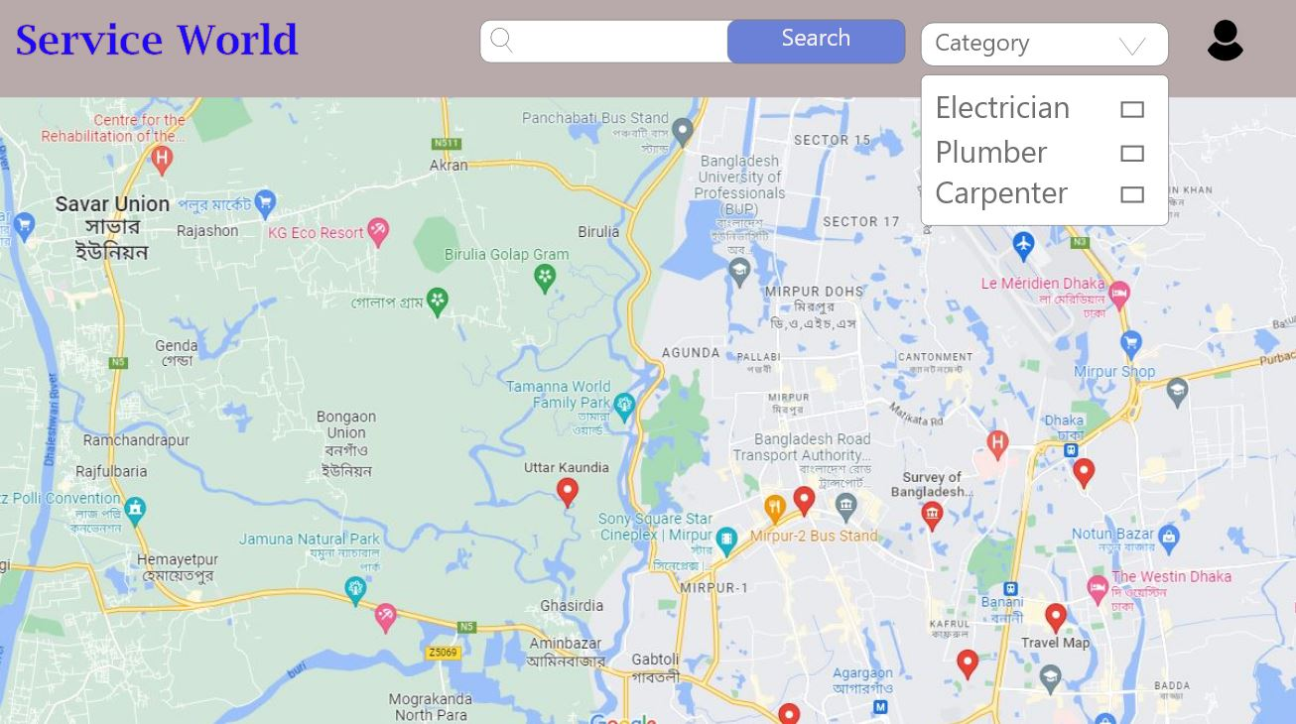

Slide 15
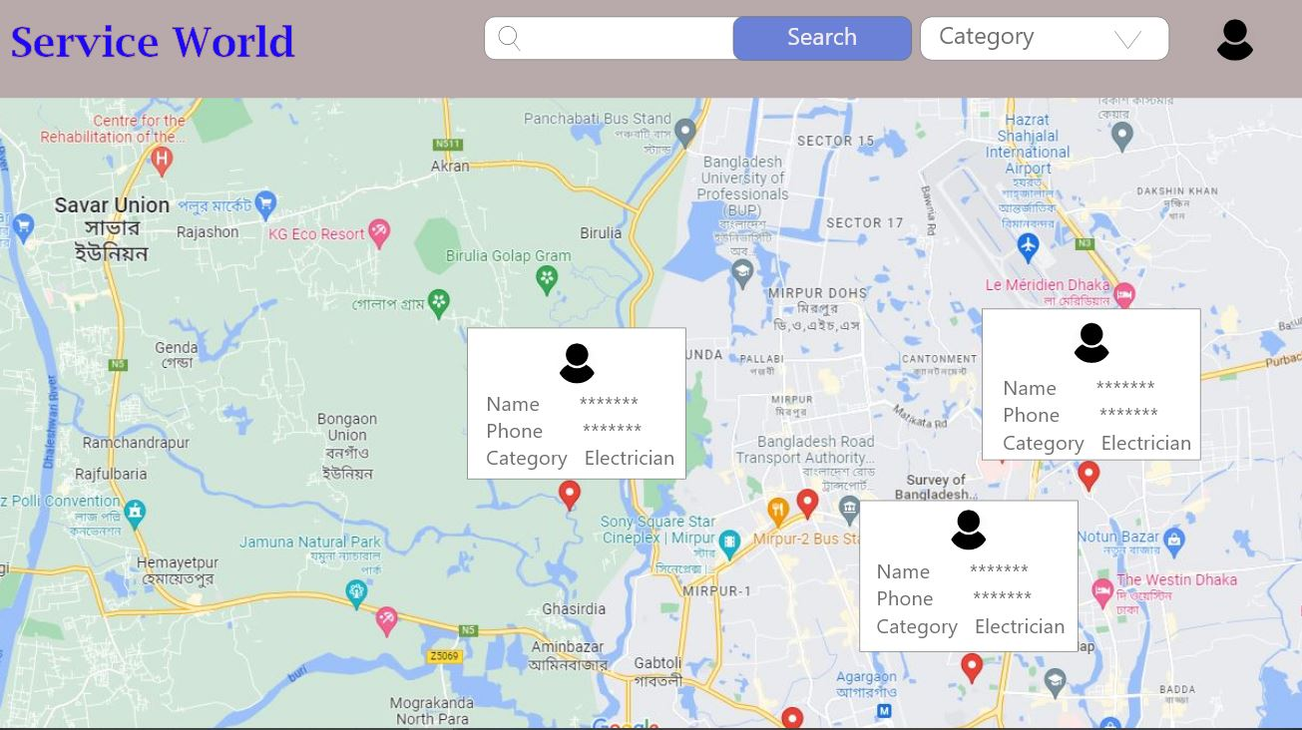

Slide 16
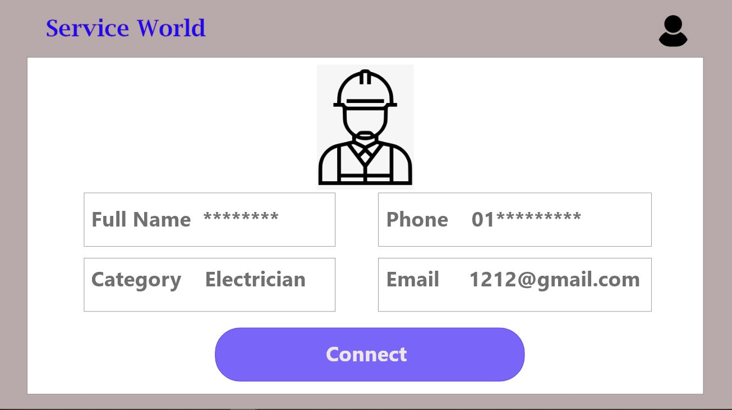

Slide 17
THANK YOU!

